Slide 1
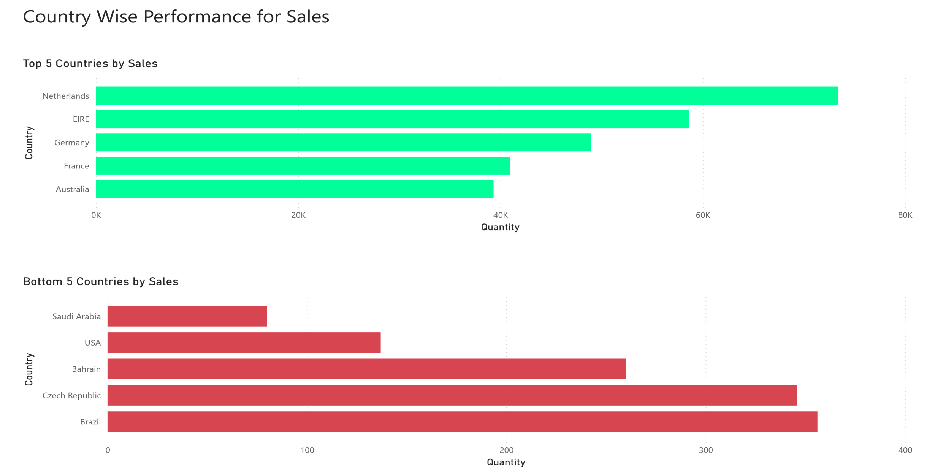

Slide 2
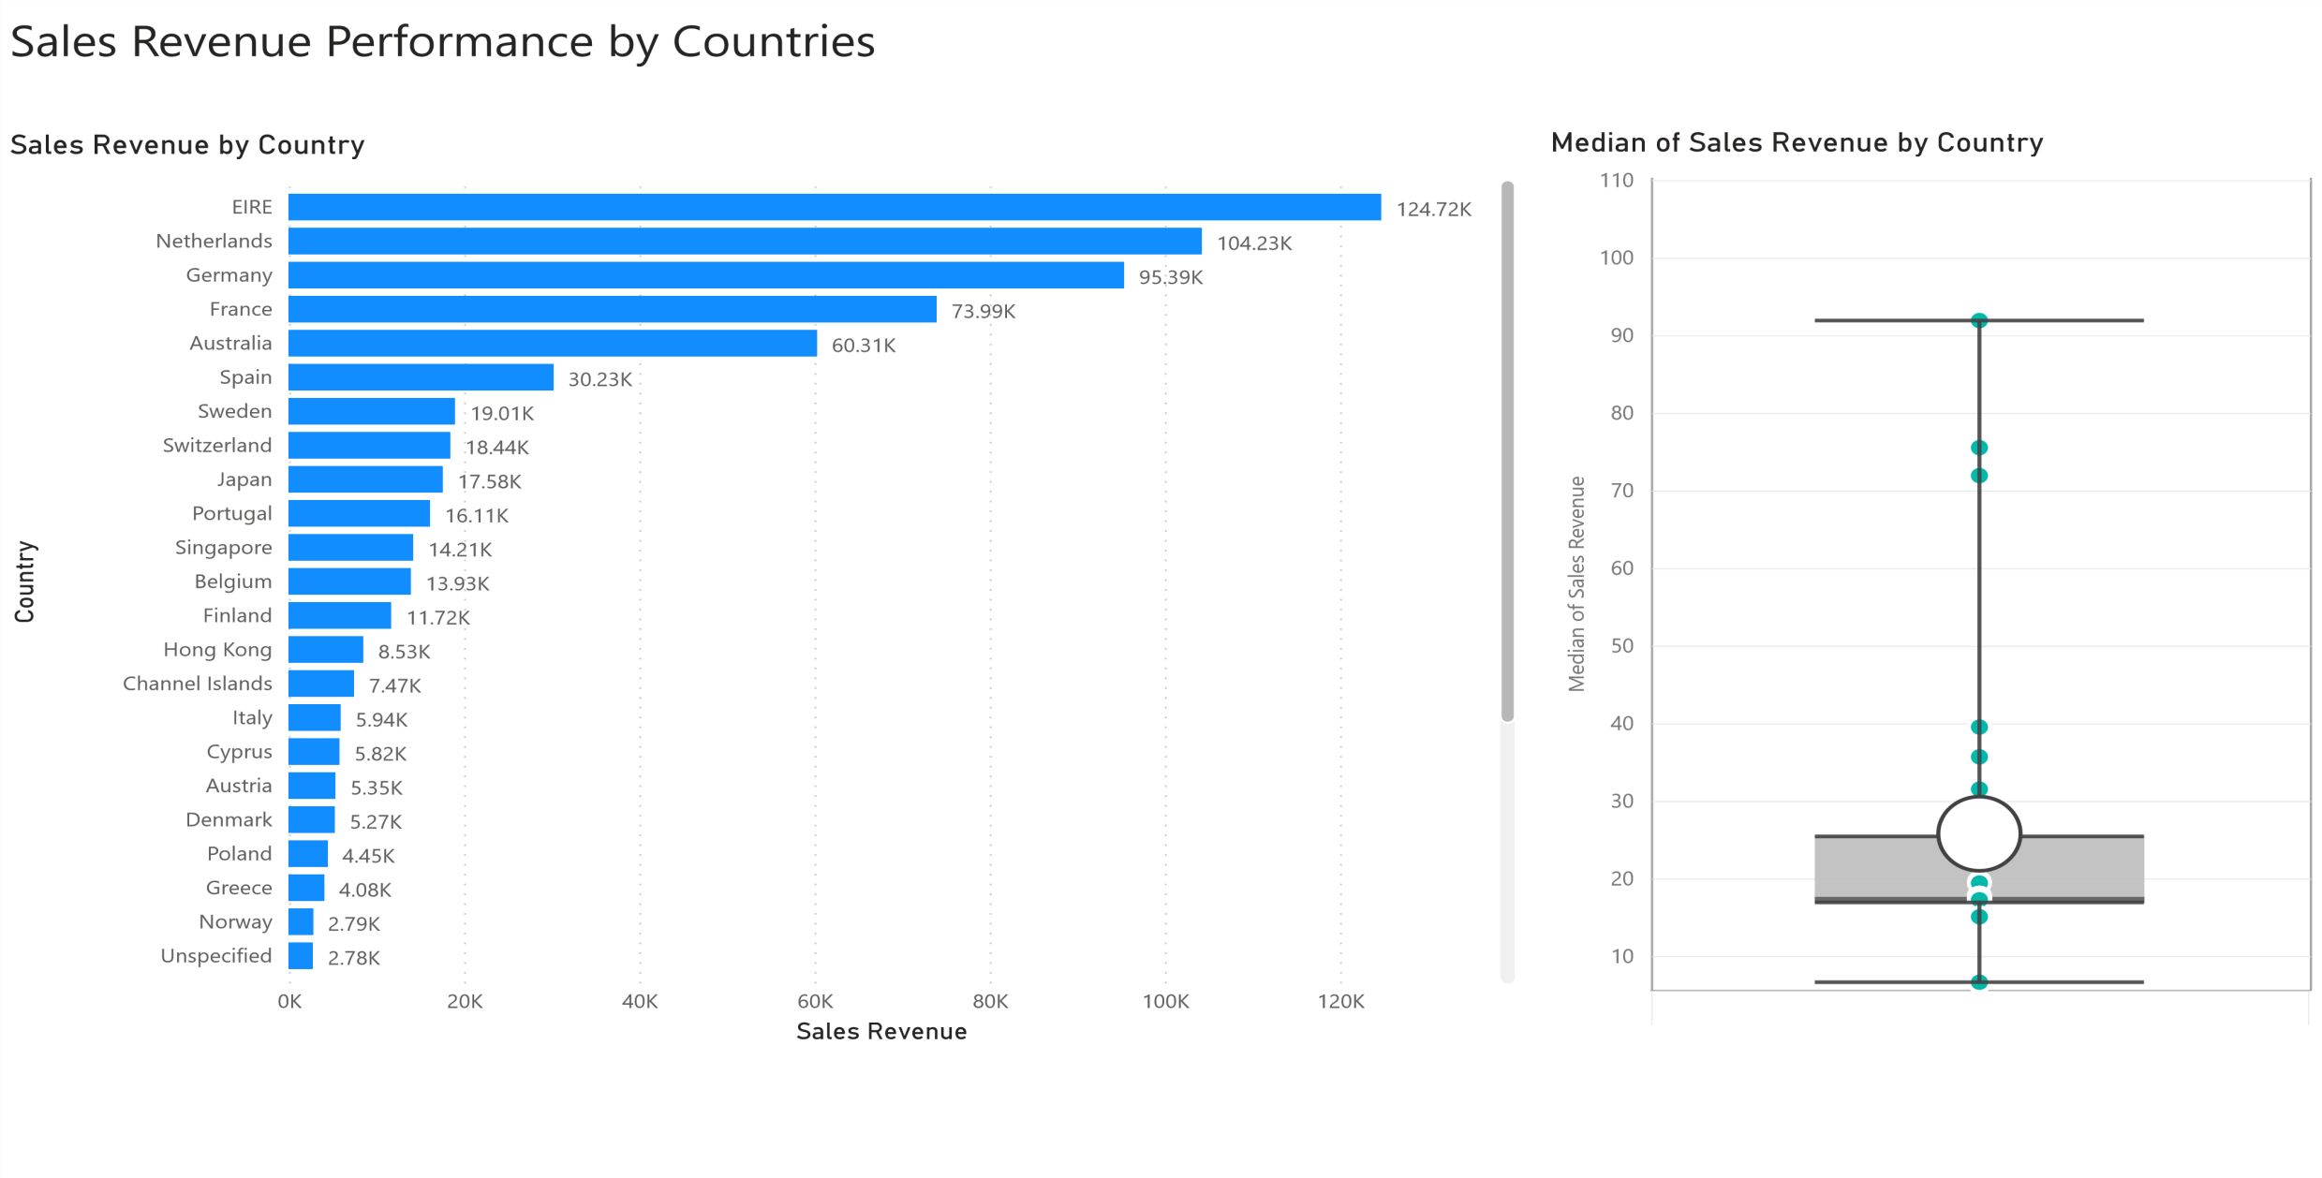

Slide 3
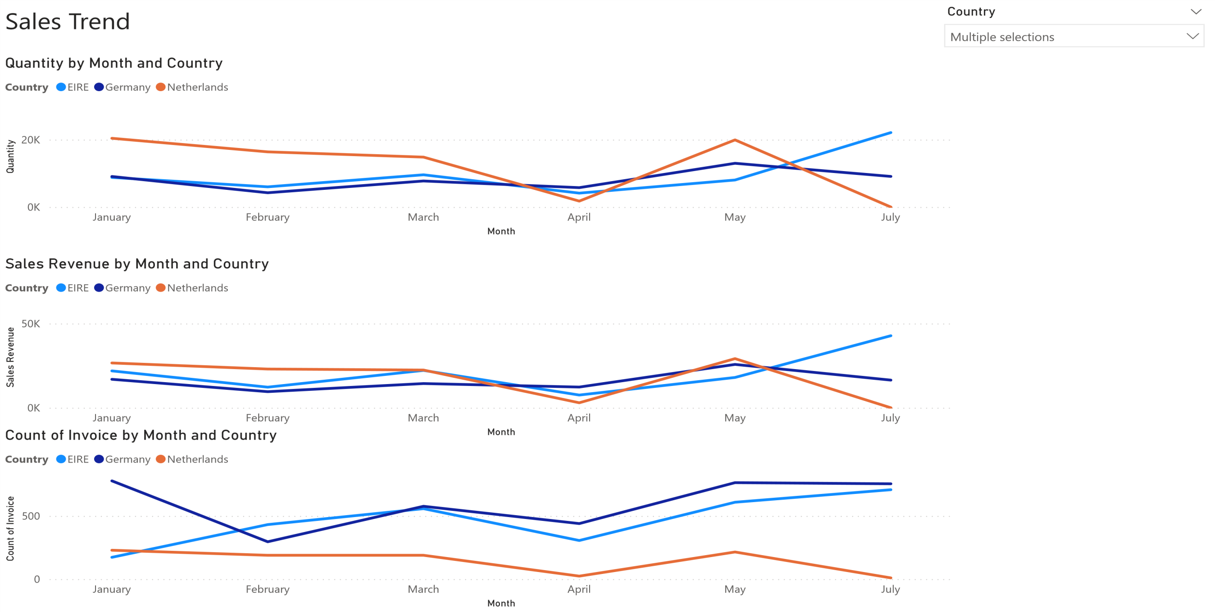

Slide 4
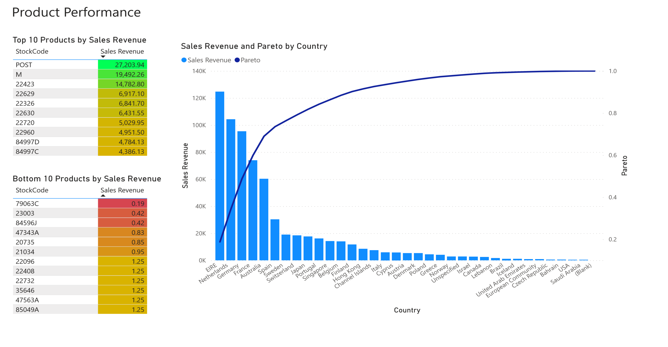

Slide 5
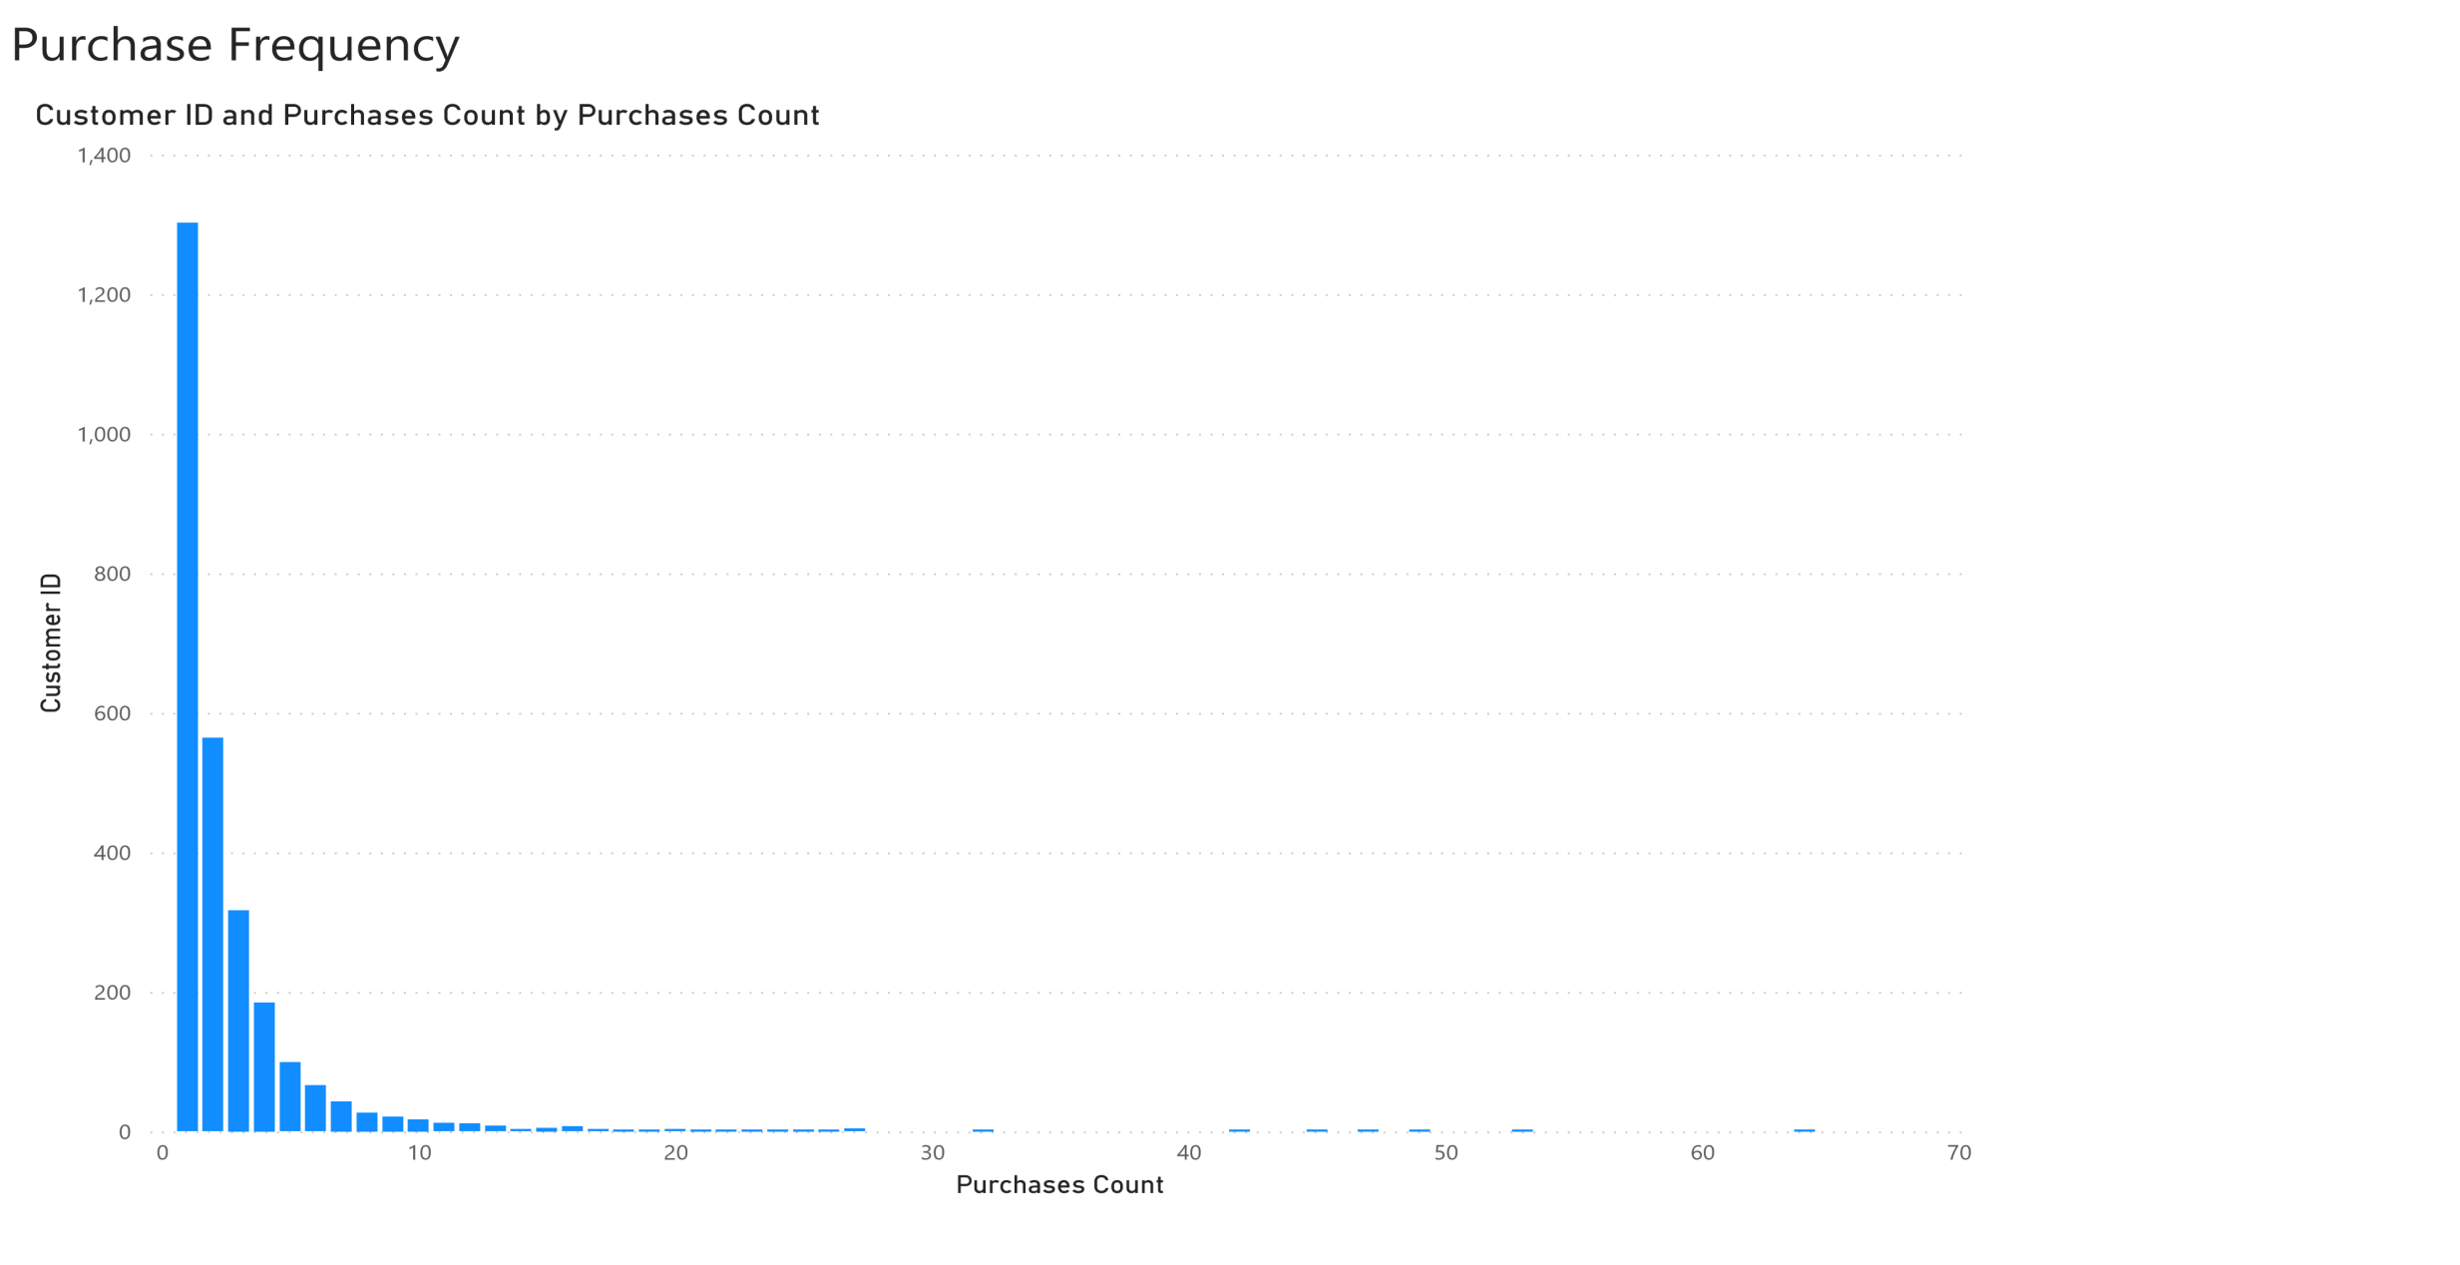

Slide 6
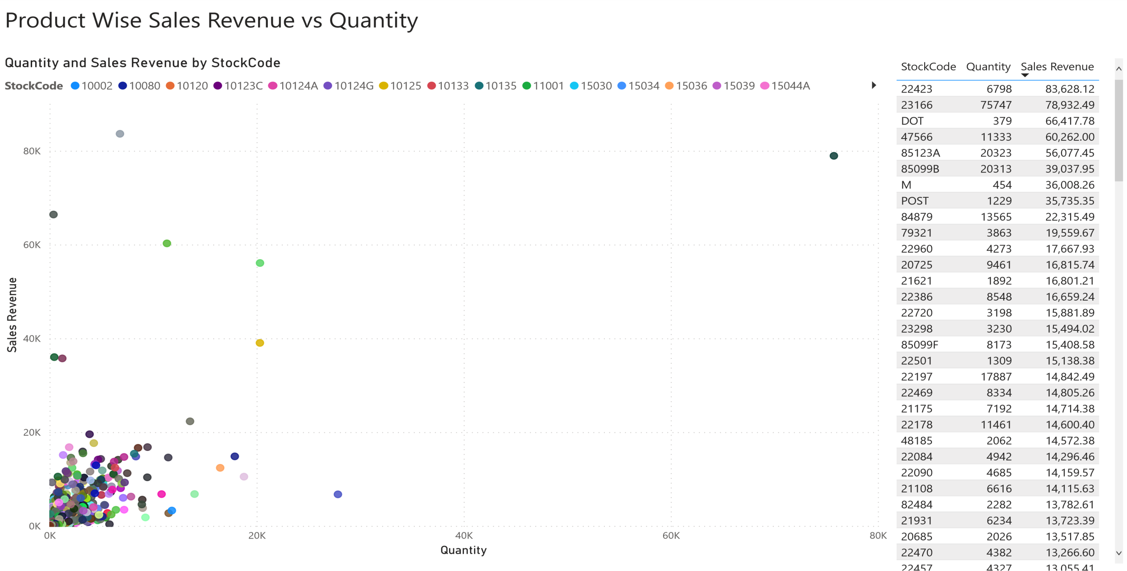

Slide 7
_{Month} 0 1 2 3 4 5 6
January
February March April May
741
152
150
201
170
280
225
496
539
361
319
260
262
290
304
368
145
120
221
430
71
94
119
54
80
July
36 24

Slide 8
